Slide 1
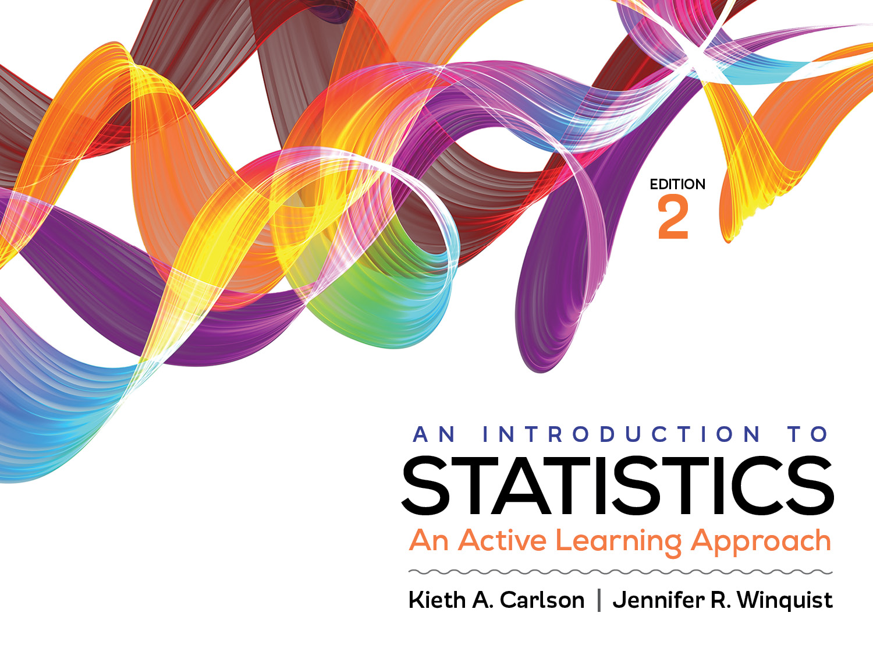
Activity 3.1: Variability

Slide 2
Activity 3.1 will require you to:
Recognize sources of variability in scores
Measurement error
Individual differences
Treatment effects
Read the variability in histograms
Explain what that standard deviation measures
Compute the standard deviation from data (histograms and frequency tables)
Use the statistics mode on your calculator

Slide 3
Sources of variability in a study
Study on which of two drugs is a better treatment for test anxiety. One group is given Drug A & another is given Drug B.
Measurement error—created by imperfect measurement procedures
Example —
Individual differences—created by fact that people are different
Example—
Treatment effects—created by experimenter treating different groups differently
Example —
Notes:
Measurement error: measuring anxiety can’t be done perfectly. Two people with the same anxiety score (e.g., 5) may not have exactly the same amount of anxiety.
Individual differences: participants who are treated exactly the same way may differ in anxiety because individuals naturally differ from each other.
Treatment effects: if one of the drugs is a better treatment for anxiety, scores will vary as a consequence.

Slide 4
Which has more variability? And why?
Are the “high”/ “low” piles close to
or far from the mean?
Mean = 3
Mean = 3
Notes:
Graphs with high “piles” (i.e., many scores) far from the mean will have more variability than graphs with high “piles” close to the mean.

Slide 5
Variability
A large part of this class is describing distributions (i.e., sets of values)
We typically describe distributions by describing their
Center (with mean, median, or mode)
Variability
Measures of variability reflect how much scores differ from each other
There are several measures of variability
Range ➔
Sum of Squares ➔
Standard Deviation ➔
Notes:
Range ➔ very imprecise
Sum of Squares ➔ hard to interpret
Standard Deviation ➔ precise and “easy” to interpret

Slide 6
Measures of variability
Range
40, 50, 21, 100, 65, 18, 35, 39
100–18 = 82 ← range (deviation between highest and lowest score)
Used when data are ordinal
Very imprecise
Sample 1: 19, 21, 21, 21, 21, 29
Sample 2: 19, 22, 25, 26, 28, 29
Standard deviation
Typical distance/deviation between scores and the mean
Used when data are interval/ratio
Same range, different variability
Notes:
Point out that the data in sample 1 is certainly more variable than the data in sample 2, but the range provides the same value for variability. This is way the range is a poor measure of variability; it is imprecise. A precise measure of variability would be chance of any of the values changed not just the Maximum and Minimum scores.

Slide 7
Computing the standard deviation Definitional method
X (scores) | X−M (deviation scores) | (X−M)²
1
3
5
6
10
M = 5 |  | SS = ∑ (X−M)² =
Notes:
Comments of slides 7-12:
Have students try to compute the answers and show their work to another student, then, show them the answers.

Slide 8
Computing the standard deviation Definitional Method
X (scores) | X−M (deviation scores) | (X−M)²
1 | −4
3 | −2
5 | 0
6 | 1
10 | 5

Slide 9
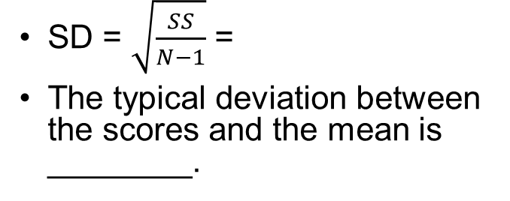
Computing the standard deviation Definitional Method
X | X-M | (X-M)²
1 | -4 | 16
3 | -2 | 4
5 | 0 | 0
6 | 1 | 1
10 | 5 | 25
 |  | SS = ∑ (X−M)² = 46
SD = $\sqrt{\frac{SS}{N−1}}$ =
The typical deviation between the scores and the mean is ________.
Sum of the Squared Deviations (SS)

Slide 10
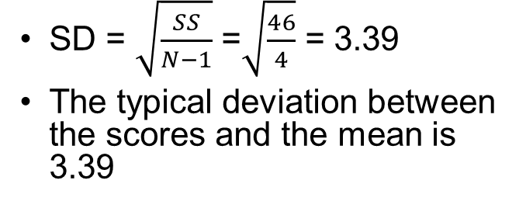
Computing the standard deviation Definitional Method
X | X−M | (X−M)²
1 | −4 | 16
3 | −2 | 4
5 | 0 | 0
6 | 1 | 1
10 | 5 | 25
 |  | SS = ∑ (X−M)² = 46
SD = $\sqrt{\frac{SS}{N−1}}$ =$\sqrt{\frac{46}{4}}$ = 3.39
The typical deviation between the scores and the mean is 3.39
Sum of the Squared Deviations (SS)

Slide 11
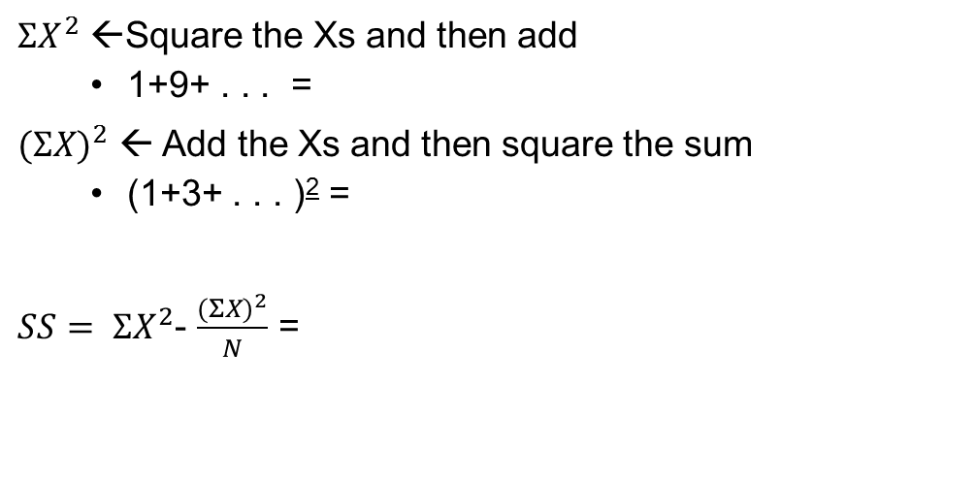
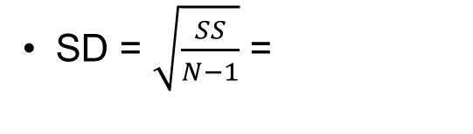
Computing the standard deviation Computational Method
X
1
3
5
6
10
${ΣX}^{2}$ ←Square the Xs and then add
1+9+ . . . =
${(ΣX)}^{2}$ ← Add the Xs and then square the sum
(1+3+ . . . )² =
$SS= {ΣX}^{2}$- $\frac{{(ΣX)}^{2}}{N}$ =
SD = $\sqrt{\frac{SS}{N−1}}$ =

Slide 12
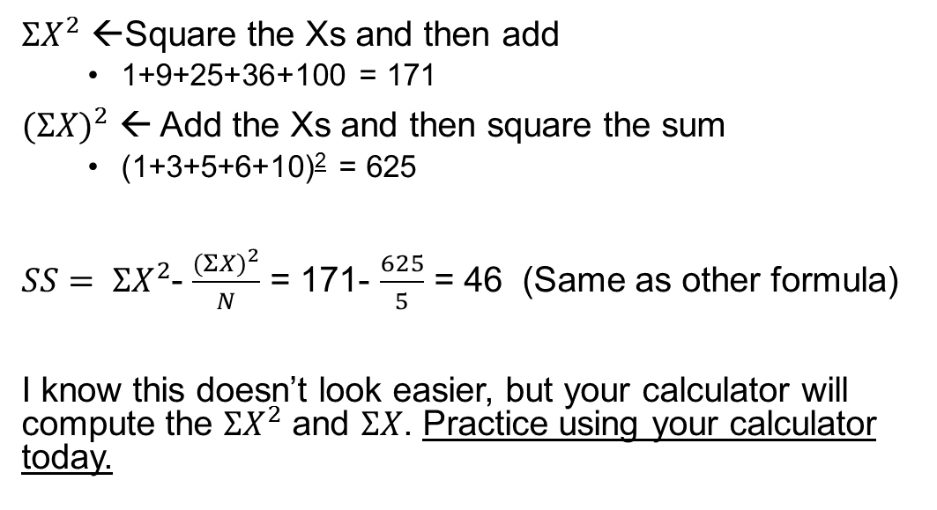
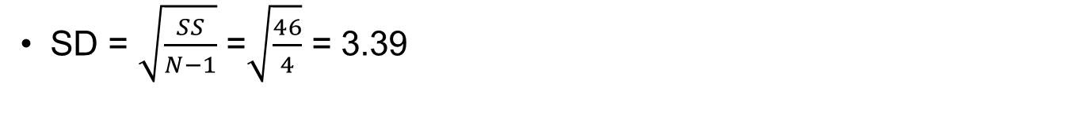
Computing the standard deviation Computational Method
X
1
3
5
6
10
${ΣX}^{2}$ ←Square the Xs and then add
1+9+25+36+100 = 171
${(ΣX)}^{2}$ ← Add the Xs and then square the sum
(1+3+5+6+10)² = 625
$SS= {ΣX}^{2}$- $\frac{{(ΣX)}^{2}}{N}$ = 171- $\frac{625}{5}$ = 46 (Same as other formula)
I know this doesn’t look easier, but your calculator will compute the ${ΣX}^{2}$ and $ΣX$. Practice using your calculator today.
SD = $\sqrt{\frac{SS}{N−1}}$ =$\sqrt{\frac{46}{4}}$ = 3.39

Slide 13
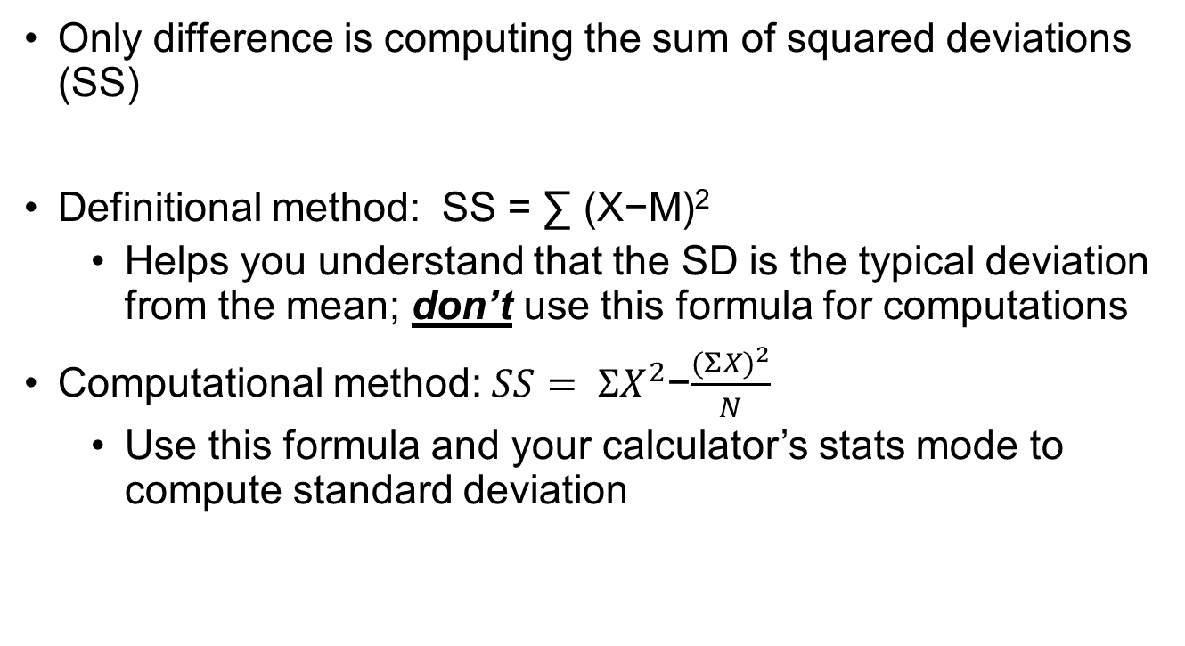
When to use each method
Only difference is computing the sum of squared deviations (SS)
Definitional method: SS = ∑ (X−M)²
Helps you understand that the SD is the typical deviation from the mean; don’t use this formula for computations
Computational method: $SS= {ΣX}^{2}$−$\frac{{(ΣX)}^{2}}{N}$
Use this formula and your calculator’s stats mode to compute standard deviation

Slide 14
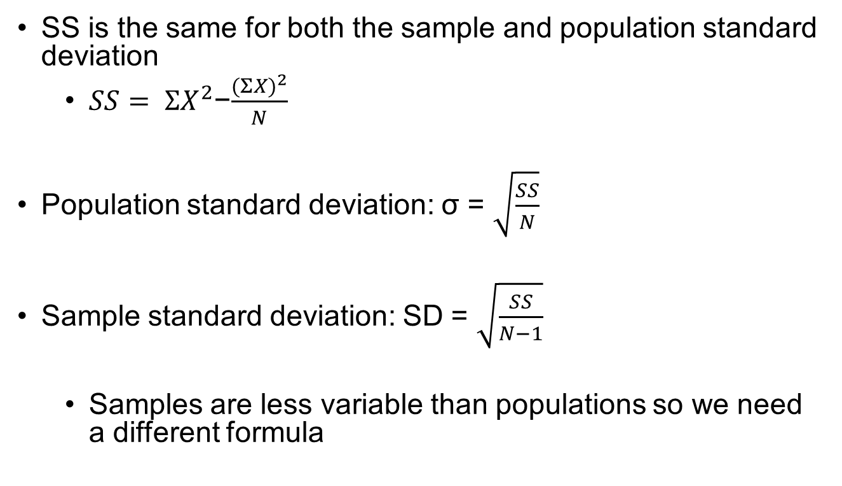
Sample vs. population computations
SS is the same for both the sample and population standard deviation
$SS= {ΣX}^{2}$−$\frac{{(ΣX)}^{2}}{N}$
Population standard deviation: σ = $\sqrt{\frac{SS}{N}}$
Sample standard deviation: SD = $\sqrt{\frac{SS}{N−1}}$
Samples are less variable than populations so we need a different formula

Slide 15
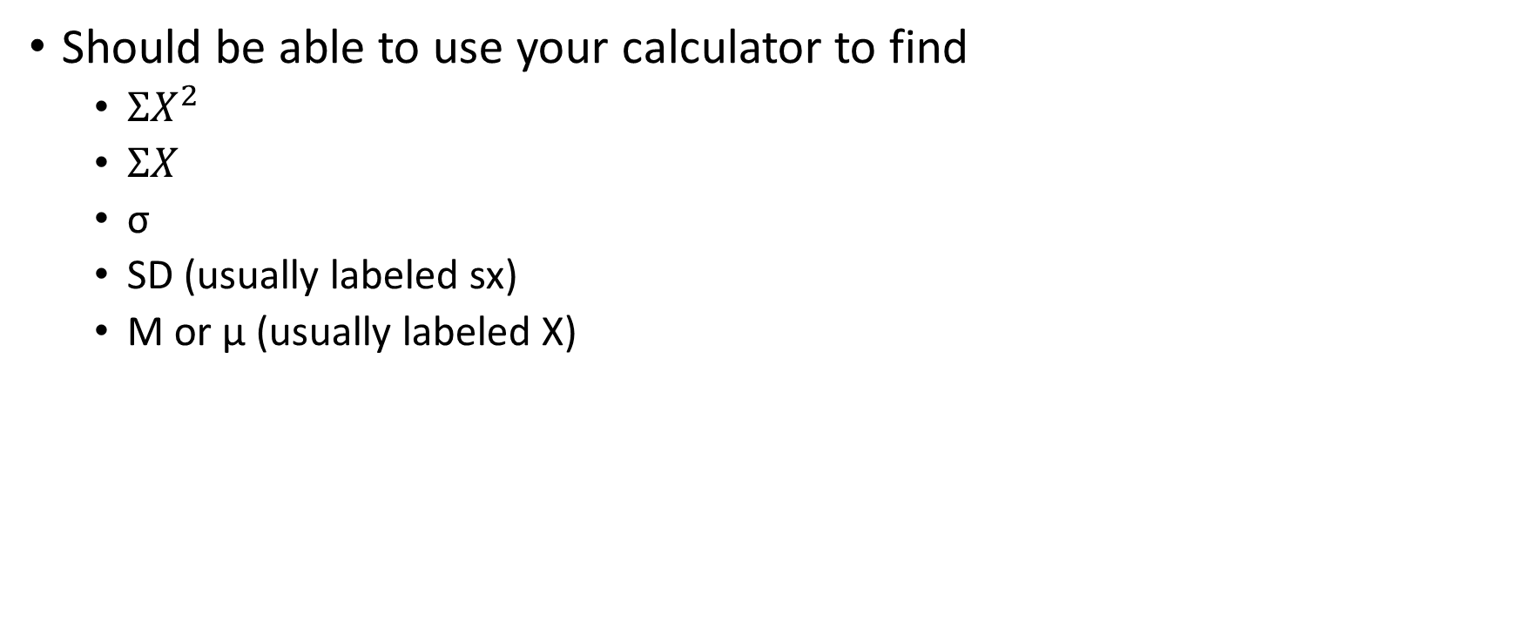
Stats mode of your calculator
Should be able to use your calculator to find
${ΣX}^{2}$
$ΣX$
σ
SD (usually labeled sx)
M or µ (usually labeled X)

Slide 16
Helpful hints
Do not just answer the questions in the activity. Be sure to read the information in the activities and understand why the answers are correct.
As always, there is new information in the activity that was not included in the readings.
Work together
Figure out how to use the stats mode on your calculator; later in the course your effort will be highly rewarded.

